Slide 2



Global Changemakers | 2025
Global Changemakers:
The UNO-Innsbruck & Sullivan Foundation Leadership Initiative
UNO and the Algernon Sydney Sullivan Foundation will launch the Sullivan Certificate in Leadership and Entrepreneurship to develop values-driven global changemakers.
01

Slide 3

Global Changemakers | 2025
The University of New Orleans (UNO) and the Algernon Sydney Sullivan Foundation announce a groundbreaking partnership launching Summer 2026 within the UNO-Innsbruck International Summer School. This collaboration introduces the Sullivan Certificate in Leadership and Entrepreneurship, combining academic study with experiential learning to develop values-driven changemakers prepared for global impact.
02

Slide 4

Global Changemakers | 2025
Two Legacies of Excellence Unite
UNO-Innsbruck International Summer School
Established in 1976, this premier study-abroad program began with 162 students on a chartered Pan Am flight to Austria. Over its nearly 50-year history, it has enrolled more than 10,000 students, becoming one of America's oldest and most respected international education programs.
The immersive six-week summer program features strong academics, international faculty, and vibrant co-curricular experiences spanning historical tours and cultural activities throughout Europe.
03

Slide 5


Global Changemakers | 2025
Two Legacies of Excellence Unite
The Sullivan Foundation
Founded in 1930, the Algernon Sydney Sullivan Foundation honors the legacy of Algernon and Mary Mildred Sullivan, 19th-century leaders exemplifying service and compassion.
For nearly a century, the Foundation has awarded scholarships and leadership honors at more than 70 colleges across the American South. Through programs like Sullivan Fellows, Ignite Retreats, and Service Corps, the Foundation empowers students to become values-driven changemakers.
04

Slide 6

Global Changemakers | 2025
The Sullivan Certificate Program: Beginning in Summer 2026, students participating in the UNO-Innsbruck program will have the opportunity to enroll in this specialized track. Upon successful completion of both courses, students will receive the Sullivan Certificate in Leadership and Entrepreneurship, recognizing their commitment to creating positive change.
05

Slide 7
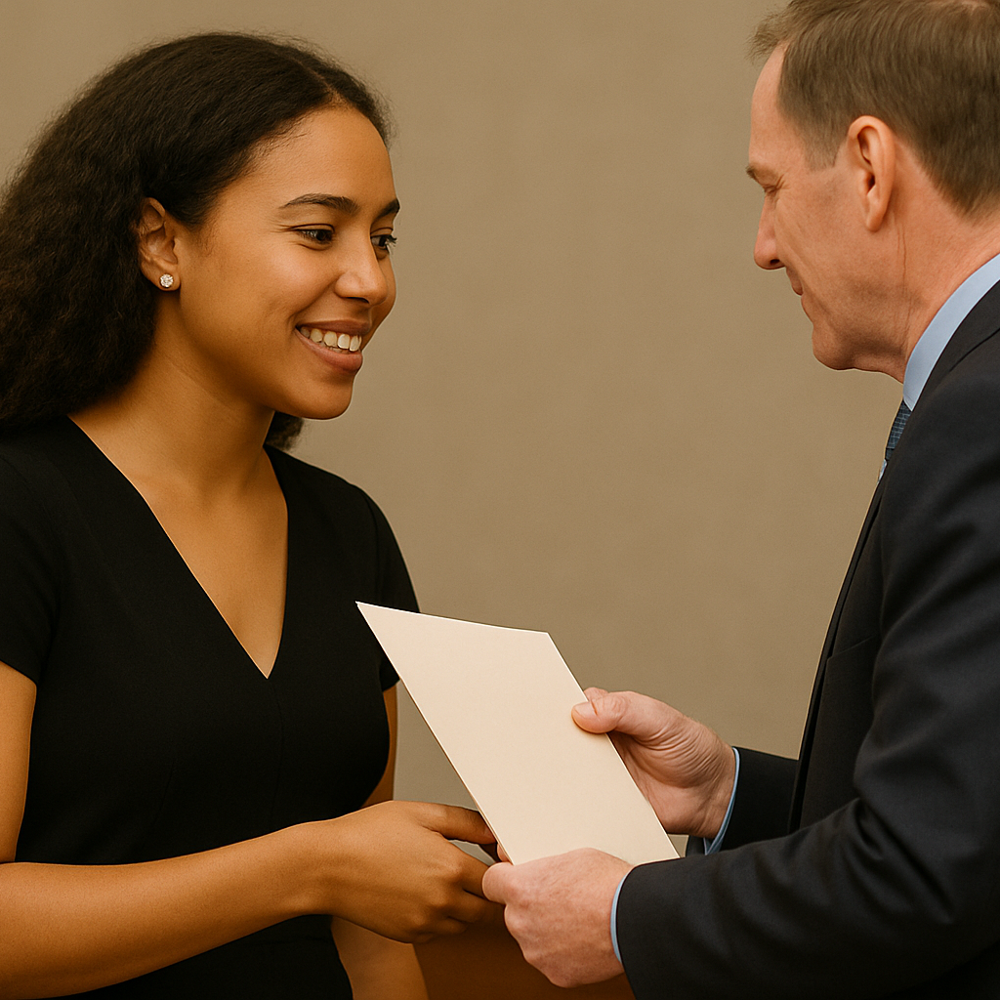

Global Changemakers | 2025
The Sullivan Certificate Program
Class 1: Leadership for Impact
A dynamic and reflective course exploring leadership styles, ethics, team building, and community-based problem solving.
Class 2: Entrepreneurship for Good
A creative, interactive course focusing on social entrepreneurship, venture creation, and innovation for public benefit.
06

Slide 8
Global Changemakers | 2025
Benefits to Students and Institutions
Academic and Professional Value
Global Experiential Learning
Academic credit applicable toward degrees
Enhanced resumes and graduate applications
Preparation for leadership across sectors
Immersive learning in Austria and beyond
Blend of theory with real-world application
International perspective on social change
Continued Engagement
Institutional Impact
Access to Sullivan alumni network
Additional changemaking programming
Community within 100-year-old foundation
UNO innovates international programs
Sullivan Foundation expands global reach
Shared commitment to service-learning
07

Slide 9



Global Changemakers | 2025
A Transformative Partnership for Global Impact
The Sullivan Certificate in Leadership and Entrepreneurship through the UNO-Innsbruck International Summer School represents a landmark partnership rooted in shared values of education, service, and innovation.
By weaving together the global reach of UNO and the purpose-driven leadership model of the Sullivan Foundation, this initiative will provide students with a powerful opportunity to grow as global citizens and social innovators.
Launching Summer 2026, this program will create a new generation of changemakers prepared to address complex challenges with creativity, compassion, and cross-cultural understanding.
08

Slide 10
Global Changemakers | 2025
An Example Day in the UNO-Innsbruck Program:
The program is structured to provide a comprehensive and engaging learning experience, with all classes meeting daily from Monday through Thursday. This consistent schedule allows students to immerse themselves fully in their studies while also leaving ample time for cultural exploration and extracurricular activities.
09

Slide 11

Global Changemakers | 2025
An Example Day in the UNO-Innsbruck Program
This daily structure balances rigorous academic content with practical application, ensuring students develop both theoretical understanding and real-world skills. Afternoons and weekends are typically reserved for cultural excursions, independent study, and personal exploration of Innsbruck and beyond.
8:00 AM - 9:20 AM
9:30 AM - 10:50 AM
11:00 AM - 12:20 PM
Morning Session: Focus on Leadership for Impact, exploring styles, ethics, and team building through dynamic discussions.
Mid-Morning Session: Delve into Entrepreneurship for Good, covering venture creation and innovation for social benefit. .
Late Morning Session: Dedicated to collaborative workshops, group projects, and interactive problem-solving sessions.
10

Slide 12

Global Changemakers | 2025
Program Details: Date, Pricing, Housing, and Application
July 3-August 7, 2026
Program Pricing & Inclusions
The program fee covers two, 3-credit hour courses, a shared en suite twin room, breakfast and lunch on class days, and travel health insurance. All planned co- and extra-curricular activities are also included, with no out-of-pocket expenses for students.
Non-UNO students: $6,695.00
UNO students: $5,795.00
11

Slide 13
Global Changemakers | 2025
Program Details: Pricing, Housing, and Application
Application Process
Secure Housing & Amenities
Applications for the summer program will open online in October, with no application fee. Next year’s minimum GPA for admission consideration will be 3.0.
All participants will reside in the modern home4students dorms at Höttinger Au, centrally located in Innsbruck and just a five-minute walk from campus.
Required Documents
Shared en suite twin rooms with access to shared kitchens.
24/7 front desk, keycard access, and program ID requirements ensure resident safety.
Features include a large ground-floor common area and a dedicated study room.
Applicants must provide a transcript from their current home university and a Home Campus Information Form (HCIF). The HCIF verifies student notification, policy advisement, and satisfaction of home campus requirements for external study abroad, ensuring grades transfer.
12

Slide 14

Global Changemakers | 2025
The world is waiting—and so is the best version of you. In Innsbruck, you won’t just study; you’ll lead, create, and connect in ways that will change how you see the world and your place in it. This is more than a summer abroad—it’s the start of a lifelong network, a global perspective, and a personal story of impact you’ll carry into every chapter of your future. Take the leap. Step into the world. Become the changemaker you were meant to be.
13

